Slide 1
Identifying and Mitigating Bias in Machine Learning Models
Jana Gunn
Sr. Principal Data Scientist

Slide 2
Objectives
1) Identify and discuss different definitions of fairness
2) Understand disparate treatment in the healthcare system
3) Quantify harms found in machine learning models
4) Review strategies for mitigating bias in machine learning models

Slide 3






What is Fairness?
Important to understand that there is no single definition of fairness.
Parity or Preference?
Statistical Parity: Representative division regardless of preference
Prefers pizza
Prefers pasta
Notes:
Does fairness mean achieving statistical parity, or satisfying the preferences of individuals within various groups?

Slide 4
What is Fairness?
Important to understand that there is no single definition of fairness.
Parity or Preference?
Preference Preservation: Strive to optimize for the preference of users
Notes:
Does fairness mean achieving statistical parity, or satisfying the preferences of individuals within various groups?

Slide 5
What is Fairness?
Avoid Disparate Treatment or Disparate Outcomes?
Procedural Fairness: All individuals with similar characteristics should receive similar decisions from the system
Equal Opportunity
Distributive Justice: All groups of individuals (as defined by specific identifiable characteristics such as race or sex) should receive similar outcomes from the system
Equal Outcome

Slide 6
Bias and Fairness
Any decision-making system can exhibit bias towards certain factors and thus, needs to be evaluated for fairness.
Data collection
Representation
Fit
Post processing
Sources of bias in machine learning
Historical
Representation
Measurement
Aggregation
Evaluation
Deployment
What may continue even with perfect sampling and feature selection
(E.g., racism)
When population is under-represented and fails to generalize for sub-groups
(E.g., CEO, hiring predictions)
When features make models blind and/or add factors that skew predictions
(E.g., spurious proxy)
When subgroups are inappropriately combined
(E.g., sex and race)
When there is unequal results representation or there are faulty performance metrics
(E.g., A1C range variations by subclass; working history as indication of credit worthiness)
When there is misuse or misinterpretation of predictive models
(E.g., use of diabetes risk score to determine donor eligibility; using a recidivism prediction model to determine length of sentence)

Slide 7
Approaches to Fairness
Fairness through Unawareness
Protected attributes are not used in prediction process
PROS:
Guaranteed not to make an explicit judgment based on a sensitive attribute
CONS:
Sometimes the attribute is important to the decision-making process (e.g. different symptoms based on the sex of a patient)
Unfairness (such as racism) can and does happen in "color-blind settings", and unawareness can mask and hide this.

Slide 8
Approaches to Fairness
Individual Fairness
Similar outputs for similar individuals
PROS:
Consistent between individuals
CONS:
"Similarity" can be difficult to define, especially when multiple overlapping metrics are involved
There is no way to check whether group fairness is also satisfied under these definitions

Slide 9
Approaches to Fairness
Group Fairness
Predicts a particular outcome for individuals across groups with similar probability (e.g. a healthcare algorithm that assigns 5% of white patients as eligible for dialysis also assigns 5% of Black patients as eligible for dialysis)
PROS:
Satisfies notions of avoiding penalizing or harming a specific group
Aligns with concerns about group equity (e.g. similar dialysis spending is granted to both Black and white patients)
CONS:
No requirement to pick the "most qualified" within each group
Can be less accurate and potentially inappropriate if base rates of a label differ

Slide 10
Approaches to Fairness
Equality of Opportunity
Probability of an outcome is the same across different classes (e.g. if a man has a 40% chance of being hired for a job, so does a woman with similar experience)
PROS:
- True positive rate is the same for all groups
CONS:
- If base rates of the labels are different, there would be different false positive rates (e.g. if a higher proportion of women are qualified for the job, more unqualified men may be hired).

Slide 11
Approaches to Fairness
Counterfactual Fairness
Decisions for a person who is a member of group X are the same as they would have been were that person a member of group Y (e.g. the algorithm makes the same decision for a Black woman as it would have if she were a white woman)
PROS:
- Aligns with an intuitive and aspirational sense of fairness without being colorblind
CONS:
- Different factors are interrelated, and the world is too complex to build models that truly estimate the counterfactual
- Defining the "similarly situated" member of the non-minority group can be difficult
-Intersectional identities further the complexity

Slide 12
Unfairness and Proxy Variables
It is entirely possible for an algorithm that has zero knowledge of the protected characteristic (e.g. sex) to be unfair and discriminatory.
- Proxy variables are closely related to sensitive feature
Examples: hair length and gender, race and zip code
An algorithm trained on a dataset that embeds systemic bias will learn and perpetuate its patterns even if blind to the protected class.
- Using healthcare costs as a proxy for disease severity

Slide 13
Disparate Treatment in the Healthcare System
Disparities in Treatment:
African Americans, both children and adults are less likely to receive appropriate pain treatment when in acute distress, even when controlling for age, sex, and time of treatment.
Up to half of medical students in one study hold the physiologically false belief that Black and white patients experience pain differently
Disparities in Diagnosis:
Women presenting to the emergency department with coronary syndromes are less likely than men with the same symptoms to be admitted to acute care.
Black patients experiencing symptoms of major depression are more likely to receive a potentially inappropriate diagnosis of schizophrenia
Medical students often only learn to diagnose important and common dermatologic findings on light colored skin, with darker skin being treated as an afterthought.
Structural Disparities:
54% of rural counties do not have a hospital with obstetrics services
Elderly LGBT individuals experience isolation, and a lack of access to culturally competent healthcare and social service providers

Slide 14
Mitigation Strategies

Slide 15
Mitigation Strategies
Within the model training stage, mitigation may occur at different steps relative to model training:
Preprocessing: A mitigation algorithm is applied to transform the input data to the training algorithm; for example, some strategies seek to remove the dependence between the input features and sensitive features.
At training time: The model is trained by an optimization algorithm that seeks to satisfy fairness constraints.
Postprocessing: The output of a trained model is transformed to mitigate fairness issues; for example, the predicted probability of readmission is thresholded according to a group-specific threshold.

Slide 16
Fairlearn Mitigation Algorithms
Algorithm | Description | Binary Classification | Regression | Supported Fairness Definitions | Sensitive Features
Threshold Optimizer | Postprocessing algorithm based on the paper Equality of Opportunity in Supervised Learning³. This technique takes as input an existing classifier and the sensitive feature, and derives a monotone transformation of the classifier’s prediction to enforce the specified parity constraints. |  |  | DP, EO, TPRP, FPRP | Categorical
ExponentiatedGradient | A wrapper (reduction) approach to fair classification described in A Reductions Approach to Fair Classification¹. |  |  | DP, EO, TPRP, FPRP, ERP, BGL | Categorical
GridSearch | A wrapper (reduction) approach described in Section 3.4 of A Reductions Approach to Fair Classification¹. For regression it acts as a grid-search variant of the algorithm described in Section 5 of Fair Regression: Quantitative Definitions and Reduction-based Algorithms². |  |  | DP, EO, TPRP, FPRP, ERP, BGL | Binary
CorrelationRemover | Preprocessing algorithm that removes correlation between sensitive features and non-sensitive features through linear transformations. |  |  |  | Binary
DP refers to demographic parity, EO to equalized odds, TPRP to true positive rate parity, FPRP to false positive rate parity, ERP to error rate parity, and BGL to bounded group loss.
Notes:
https://fairlearn.org/main/user_guide/mitigation.html

Slide 17
Use Case – Increasing downloads of a MSK mobile application
Objective: Develop a classification model that identifies which members are most likely to download a mobile application for musculoskeletal (MSK) therapy. Model will be used to send marketing materials to individuals that qualify, encouraging them to download the application.
Sample: Members that qualified for the mobile app between 1/1/2021 and 7/15/2021.
Data:
Amerilink Consumer Database
Medical and Rx Claims
County Health Rankings
Food Environment Atlas
Target Variable: Members that have downloaded the mobile application.

Slide 18
Fairness Considerations
Data
Determining what data to use to train the model is another critical component of the machine learning process. Several factors should be considered including:
Sample sizes of different groups (i.e. race, ethnicities)
Representativeness of population
Appropriateness of choice of label
Label imbalance
Adequate features for prediction
Privacy considerations

Slide 19
Types of fairness-related harms
Allocation harms: Opportunities are unintentionally withheld from certain members of society
Quality of service harms: System works well for some groups but not others
Representation harms: System produces results that exacerbate stereotypes or under- represent certain populations
These are not mutually exclusive, meaning AI systems can exhibit more than one type of harm.

Slide 20
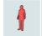
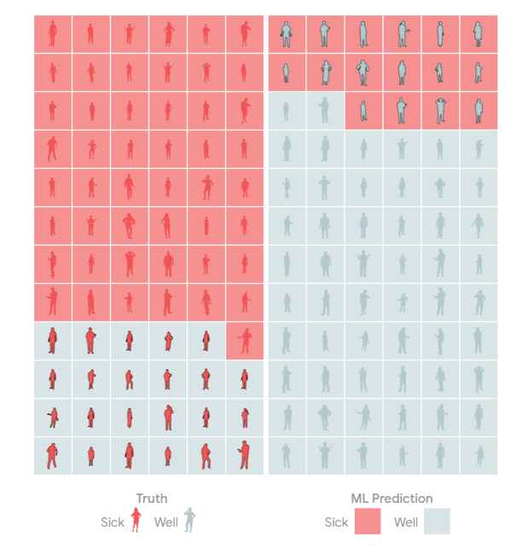
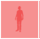
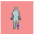

Quantify Harms
Members could experience allocation harm if they would benefit from the mobile app but are not notified about it. These individuals would be considered false negatives in our classification model.
We will use two metrics to measure harm:
False Negative Rate: fraction of members that would download the app, but are NOT marketed to
False Negative / (True Positive + False Negative)
Selection Rate: overall fraction of members that are sent marketing materials (regardless of whether they would download it)
(True Positive + False Positive) / (True Positive + False Positive + True Negative + False Negative)
+
+
+
+
+

Slide 21
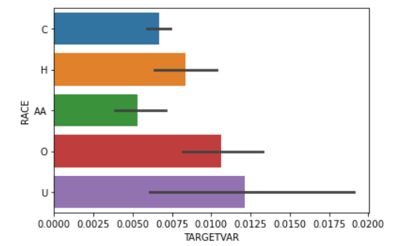
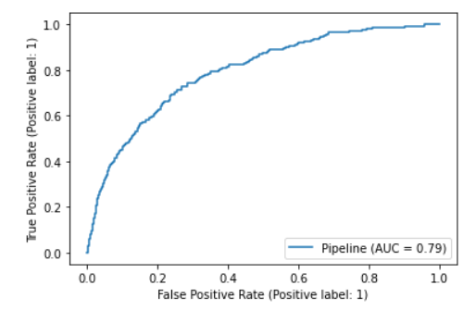
Train the model
1) Split data into training and testing datasets
Balance training data – there should be an equal amount of positive and negative labels
Testing data will remain unbalanced
2) Run the logistic regression model
3) Examine performance metrics and coefficients
AUC: 0.79
Balanced Accuracy: 0.73
Average download rate: 0.7%

Slide 22
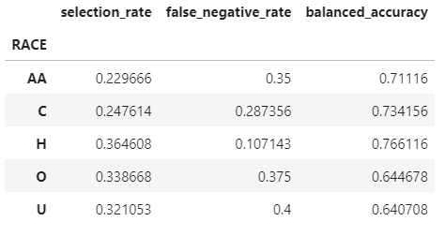
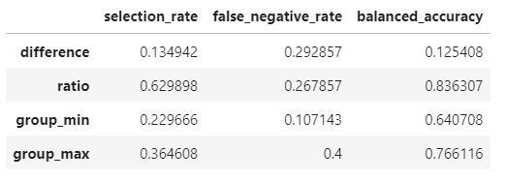
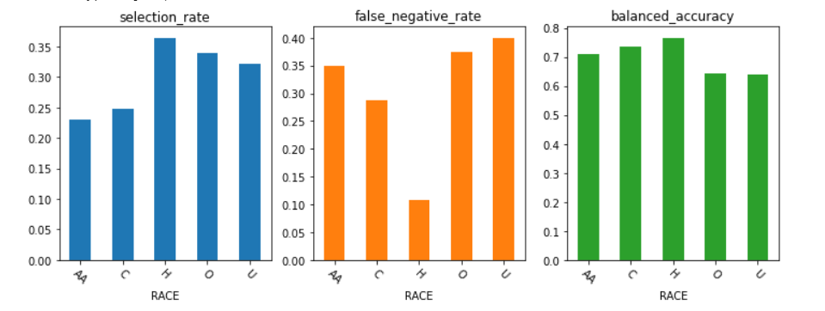
Calculate Fairness Metrics
Identifying harms
Individuals with “Other” or “Unknown” race have the higher false negative rates and lower accuracy.
A larger fraction of group members that are likely to benefit from the mobile App are not selected (false negative rate).
Individuals are not correctly classified as often as other groups (accuracy).

Slide 23

Postprocessing with Fairlearn ThresholdOptimizer
ThresholdOptimizer is a meta-algorithm in that it acts as a wrapper around any standard (fairness-unaware) machine learning algorithm.
ThresholdOptimizer is a postprocessing technique.
It takes an already trained model and a dataset as an input and seeks to fit a transformation function to the model's outputs to satisfy some (group) fairness constraint(s).
One limitation of ThresholdOptimizer is it needs access to sensitive features during training and at deployment time.

Slide 24
Use Case – ThresholdOptimizer Results
Threshold Optimizer minimizes the difference in the training data, however, does not hold up in the testing data suggesting the need for a larger sample size.

Slide 25
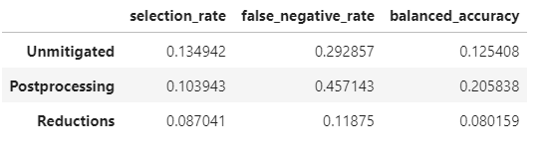
Reductions approach with Fairlearn ExponentiatedGradient
ExponentiatedGradient is a reductions approach of Agarwal et. al (2018) to obtain a model that satisfies the fairness constraints, but does not need access to sensitive features at deployment time.
ExponentiatedGradient creates a sequence of reweighted datasets and retrains the wrapped model on each of them. The retraining process is guaranteed to find a model that satisfies the fairness constraints while optimizing the performance metric.
Difference
The reductions approach reduces the difference in all three metrics.
Notes:
Agarwal, Beygelzimer, Dudik, Langford, Wallach “A Reductions Approach to Fair Classification”, ICML, 2018.

Slide 26
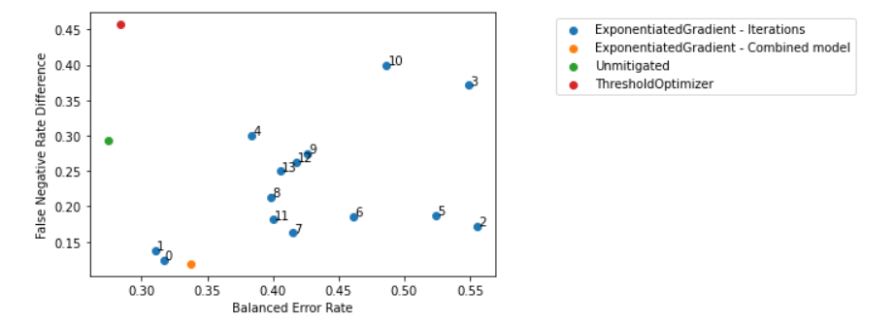
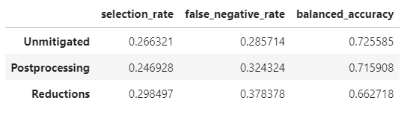
Use Case – Mitigation Comparison
The mitigated model using ExponeniatedGradient has a higher balanced error rate but a much smaller false negative rate difference.

Slide 27
Pre-Processing Techniques
Imbalanced Data: Some sensitive group are under-represented causing the model to be unable to perform similarly across all groups
Sampling and Reweighing: Adjusts balance of different groups presenting more learning opportunities for under-represented groups
Data with Historical Bias: Causes model to learn discriminatory behavior from existing bias in the historical data
Relabeling: Biased labels cause significant differences in false positives and false negatives between sensitive groups
Change labels for records that have same features but different outcomes
Data Transformations: Models can indirectly infer association of certain records with sensitive groups based on certain features (i.e. zip code, sports)
- Reduce or eliminate the correlation between sensitive attributes and other features as well as the target
Due to the blindness of these techniques to models’ inference of the data, some level of bias can still creep into the model predictions.

Slide 28
Reweighing Technique
Disparate Impact (DI)= Probability of download given the person is not Caucasian divided by the probability of download given the person is Caucasian.
- For our fairness benchmark, we require that 1 - min(DI, 1/DI) < 0.2

Slide 29
Reweighing Technique
Reweighing is a preprocessing technique that weights the examples in each (group, label) combination differently to ensure fairness before classification.
Calculate weight for each group and label combination:

Slide 30
Use Case -Takeaways
1) There is tradeoff between overall accuracy of the model and minimizing the difference in false negative rates between the groups.
2) The mitigated model using ExponeniatedGradient has a higher balanced error rate but a much smaller difference in false negative rate.
3) The disparate impact between Caucasian and Non-Caucasians is within the threshold of being fair.
4) More data will help identify if a mitigation algorithm is required.

Slide 31
Summary
1) Machine learning models should demonstrate parity across identified sensitive groups.
2) It is important to not only identify disparities, but also mitigate them.
3) Mitigation can occur during pre-processing, at training time, or during post-processing.
4) Determining which algorithm to use is a tradeoff between performance and level of parity.

Slide 32
Resources
Example code to run Fairlearn’s MetricFrame, ThresholdOptimizer, and Exponeniated Gradient:
SciPy 2021 Tutorial.ipynb - Colaboratory (google.com)
Example code to run Fairlearn’s GridSearch:
https://github.com/fairlearn/fairlearn/blob/main/notebooks/Grid%20Search%20for%20Binary%20Classification.ipynb
Reweighing using AIF360:
https://nbviewer.org/github/IBM/AIF360/blob/master/examples/tutorial_credit_scoring.ipynb
Model remediation with TensorFlow:
https://www.tensorflow.org/responsible_ai/model_remediation
Technique for dealing with bias when no sensitive features are available:
https://arxiv.org/pdf/1806.08010.pdf
Summary of multiple bias mitigation techniques:
https://towardsdatascience.com/algorithmic-solutions-to-algorithmic-bias-aef59eaf6565

Slide 33
References
¹ Agarwal, Beygelzimer, Dudik, Langford, Wallach “A Reductions Approach to Fair Classification”, ICML, 2018.
² Agarwal, Dudik, Wu “Fair Regression: Quantitative Definitions and Reduction-based Algorithms”, ICML, 2019.
³ Hardt, Price, Srebro “Equality of Opportunity in Supervised Learning”, NeurIPS, 2016.

Slide 34
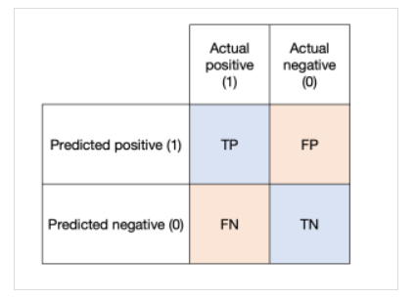
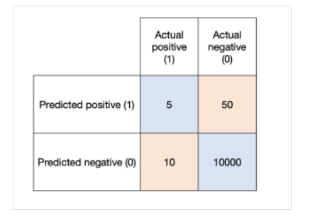
Accuracy vs Balanced Accuracy
Balanced accuracy should be used as the target metric on imbalanced datasets.
Accuracy: (TP + TN) / (TP + FN + FP + TN)
Sensitivity: TP / (TP + FN)
Specificity: TN/ (TN + FP)
Balanced Accuracy: (Sensitivity + Specificity) / 2
Example:
Accuracy: ( 5 + 10000) / (5 + 10 + 50 + 10000) = 99.4%
Sensitivity: 5 / (5 + 10) = 33.3%
Specificity: 10000 / (10000 + 50) = 99.5%
Balanced Accuracy = (33.3% + 99.5%) / 2 = 66.4%
Model is not doing much better than a random guess (i.e. 50%)

